Slide 1
Farm Management Information System (FMIS) Training
McGee Christmas Tree Farm

Slide 2
Background
The FMIS is a tool for the farm manager to understand the amount and distribution of work on the farm.
This tool was created with open source software to make it the lowest cost solution possible
Any questions that cannot be answered by the procedure of this training can be directed to spencer.e.smith@hotmail.com

Slide 3
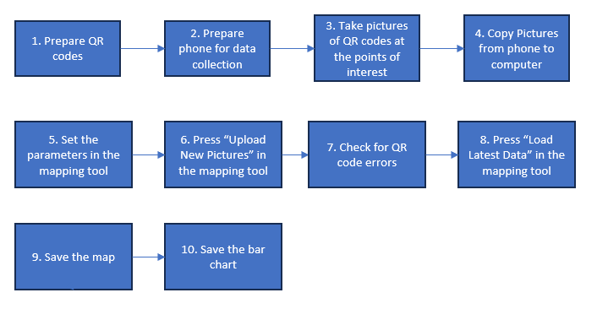
Flowchart

Slide 4
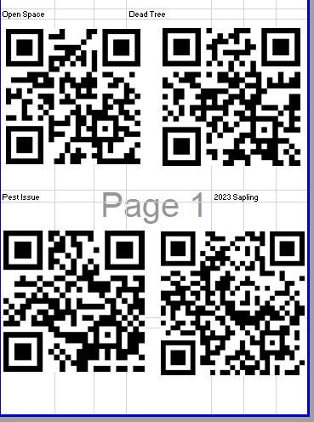
QR codes
Create QR codes in in the QR Code excel file
4 QR Codes per page is recommended
When the QR codes are generated and formatted, print the page(s) for use during data collection

Slide 5
Prepare Phone
GPS On
50Gb of Storage
Turn off live photos
Take a test photo and upload it to the Computer to check for GPS data

Slide 6
Collect Data
At each point of interest, take a picture of the QR code corresponding to the situation at the point of interest.
QR code must be in full sunlight or full shade. Partial shade on the QR codes will made it unreadable.
Including more than one QR code in the picture will also cause a failure to read the QR code

Slide 7
Copy Pictures From Phone to Computer
Plug the phone in using a USB cable
File folder that contains the pictures on the phone
Copy all applicable pictures
Paste the pictures into a folder and name it approriately

Slide 8
Set Mapping Tool Parameters
Enter the folder path for the output data
Enter the path for the Aerial Photo
Enter the path for the Input Pictures
Enter subset of tasks to include (optional)

Slide 9
Upload Pictures
Press “Upload New Picture”
The window will not respond while the program extracts the data from the pictures. Do not interact with the window until the program has finished.

Slide 10
Check QR Code Errors
In the Data storage folder find the most recent errors file
Open each photo that is listed in the error file determine which QR code is was meant to have.
Change the file name of each photo to include the description of the QR code inside parentheses. For a description of “Dead Tree” add (Dead Tree) into the name of the file.

Slide 11
Upload New Pictures Again
If errors were repaired in the previous step then press “Upload New Pictures” again
This will take as much time to run as it did the first time

Slide 12
Generate Map
Press “Load Latest Data”
The window will be unresponsive until the map appears
The map will appear in a new window
A copy of the map is saved in the Data Storage location

Slide 13
Generate Bar Chart
The bar chart is generated when the map is closed
It will automatically open in the default browser
The bar chart can be saved by clicking the camera icon in the top right corner

